Slide 1
Applications of Microbiome in health and clinic
August 08 2024
Phuc Loi Luu, PhD
Luu.p.loi@googlemail.com

Slide 2
Content
Review of Microbiome
The Gut Microbiome and Health
The Skin Microbiome and Clinical Applications
The Oral Microbiome and Clinical Applications
The Microbiome and Future Directions

Slide 3
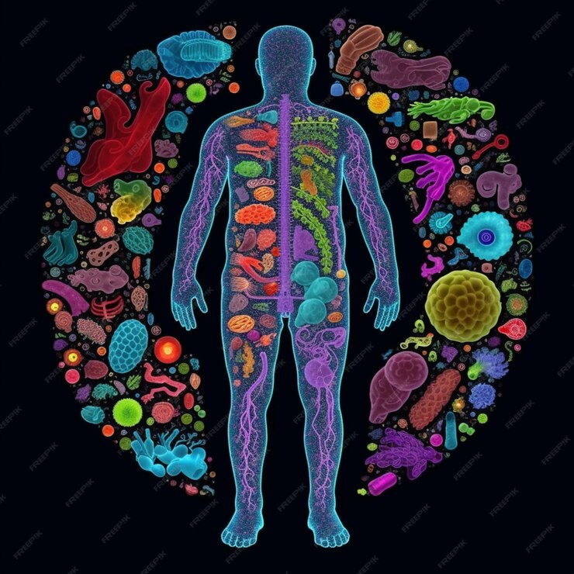
The Human Microbiome: A Complex Ecosystem
Definition: The microbiome is the collection of microorganisms (bacteria, fungi, viruses, and others) that live in and on the human body.
Importance: Crucial for human health, involved in digestion, immune function, metabolism, and protection against pathogens.
Diversity: Varies by body site (gut, skin, oral cavity, etc.) and individual.

Slide 4
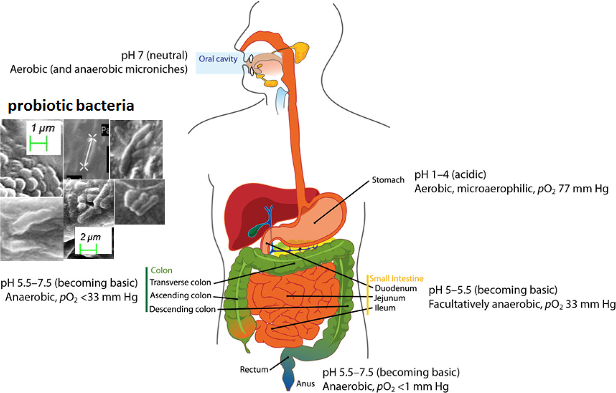
The Gut Microbiome: A Key Player in Health
Composition: Primarily bacteria, with diverse species.
Role in health: Digestion, nutrient absorption, immune system development, and mental health.
Clinical applications:
Gut disorders (Irritable Bowel Syndrome, Inflammatory Bowel Disease)
Metabolic diseases (obesity, type 2 diabetes)
Mental health conditions (depression, anxiety)
Fecal microbiota transplantation (FMT) for recurrent Clostridium difficile infection
10.1021/acs.jafc.1c00468

Slide 5
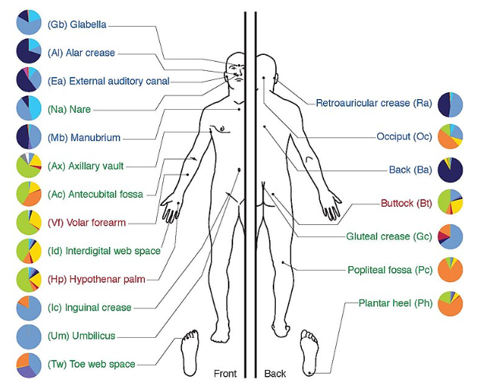
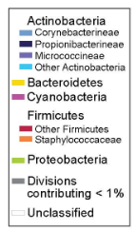
The Skin Microbiome: Our First Line of Defense
Composition: Diverse community of bacteria, fungi, and viruses.
Role in health: Skin barrier function, immune response, and protection against pathogens.
Clinical applications:
Skin disorders (eczema, psoriasis, acne)
Wound healing
Allergic diseases
Probiotic skincare products
https://en.wikipedia.org/wiki/Skin_flora

Slide 6
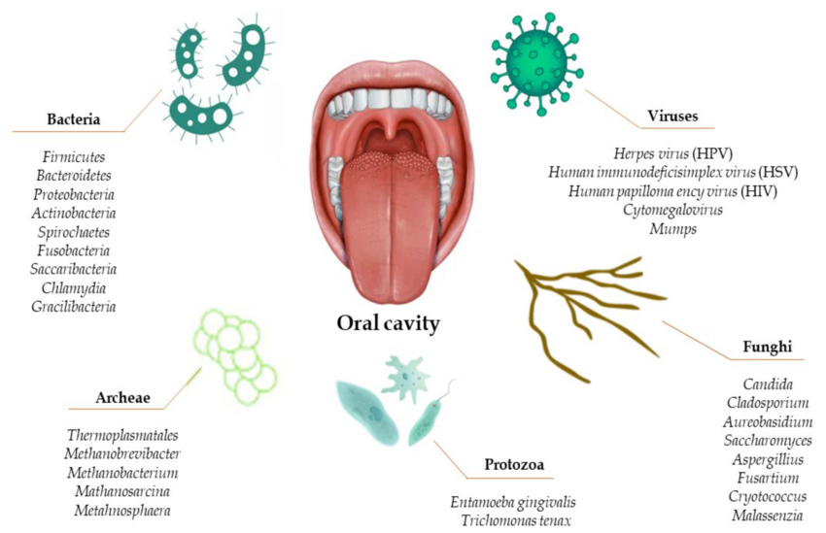
The Oral Microbiome: A Complex Ecosystem
Composition: Diverse community of bacteria, fungi, and viruses.
Role in health: Oral health, digestion, and immune response.
Clinical applications:
Dental caries
Periodontal disease
Oral cancer
Systemic diseases (heart disease, diabetes)
10.3390/nu14122426

Slide 7
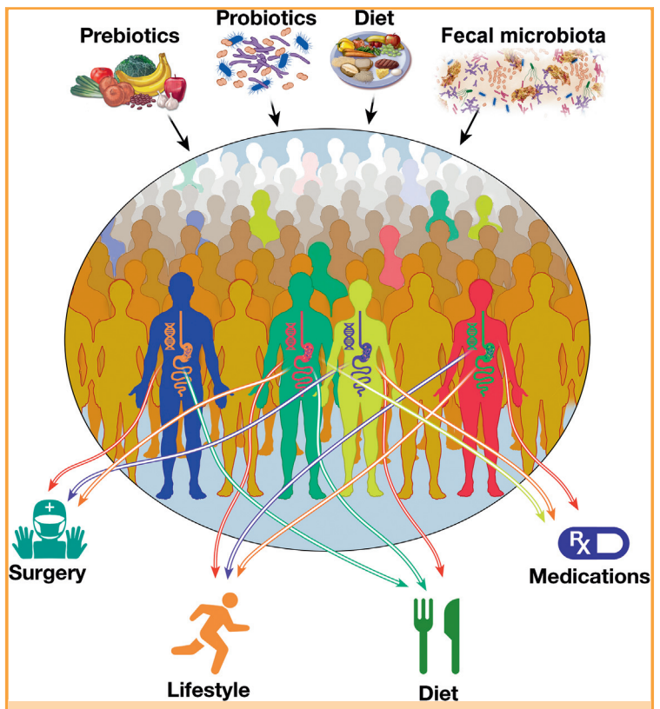
The Microbiome: A Frontier in Medicine
Personalized medicine: Tailored treatments based on individual microbiome profiles.
Probiotics and prebiotics: Potential therapeutic agents for various diseases.
Microbiome-based diagnostics: Early detection of diseases.
Challenges: Standardization of microbiome research, ethical considerations.
https://doi.org/10.1016/j.mayocp.2017.10.004

